Slide 1
FARMER’S GUIDE -Pathway to prosperity
Dhanunjay Reddy:160118737026
Jaisai kuntala:160118737027
Under the guidance of :
Dr.B.Veerajyothi.

Slide 2
Contents
Introduction.
Existing system.
Proposed system.
Software & Hardware Requirements.
Implementation, Results and Screenshots.
Conclusion & Future scope.

Slide 3
Introduction
This project is designed to educate farmers in each and every aspect of agriculture.
Right from the crop suggestions to the post harvest technologies, every minute thing is incorporated in our project.
Provision of high security to the information, the inclusion of the query clearance module etc. are the pursuits of the FARMER’S GUIDE.

Slide 4
Existing System
There are few web portals to serve this purpose.
Previous year’s statistics are not provided.
Most of the suggestions are not relatable to the practical situations.
Do not provide the opportunity of query clearance.

Slide 5
Proposed system
It allows farmers to create their own logins, which provides high security to their personal details.
They can have crop suggestions based on the climatic conditions and the type of soil in their region.
They can get the access to all the information regarding the crop production, previous year’s statistics, market information, policies and schemes, ICT applications in agriculture, post harvest technologies etc. after they login.
One of the major part is the query clearance module by which a farmer can :
Ask a query.
Answer the already existing queries of other farmers.
View the solutions of their own queries in their respective logins.

Slide 6
Software Requirements
Operating systems: Windows* 7 or later, mac OS, and Linux.
Included development tools : Dev C++, Notepad.

Slide 7
Hardware Requirements
Processor : Intel®Core™ i7-8700 CPU @ 3.20GHz
32-64 bit processor.
Hard Disk Space : 1 GB.
Input device (mouse /keyboard) to select options .
Sufficient RAM to run the program (Minimum 2GB).

Slide 8
Implementation
The system extensively uses the linear data structure(linked list) for efficient information storage and retrieval.
The file concepts in C++ are used to handle the user logins, the query clearance module, etc.

Slide 9
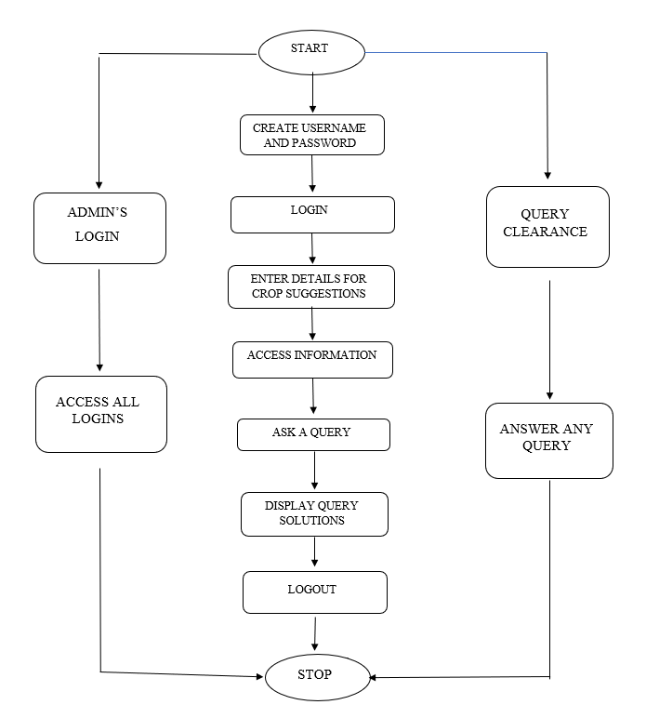
Architecture
Of the proposed system.

Slide 10
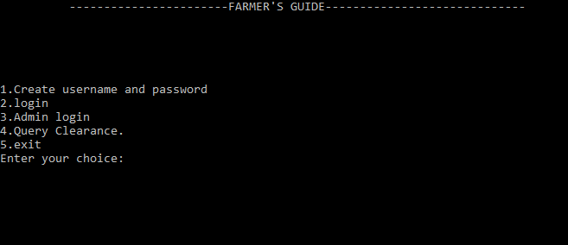
Main page :

Slide 11
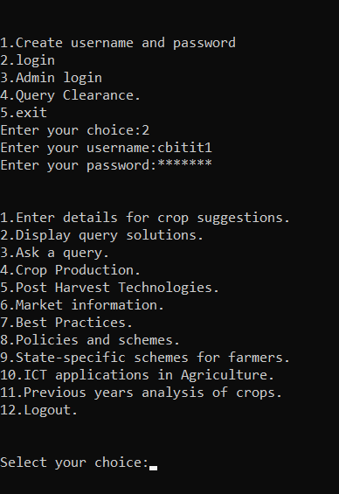
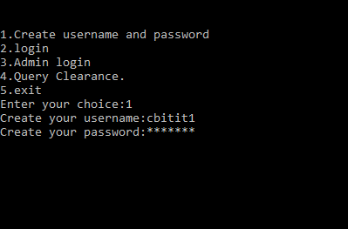
Creating username, Password. Login.

Slide 12
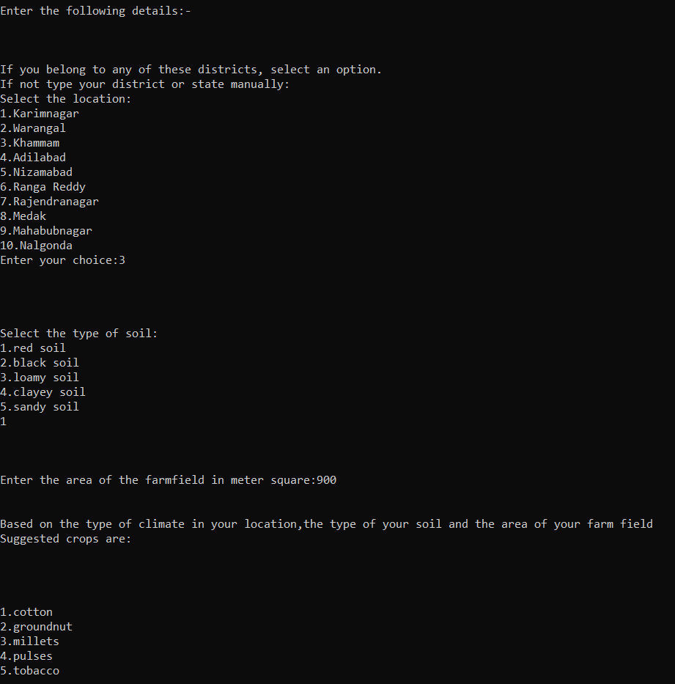
1.Enter Details For Crop Suggestions :

Slide 13
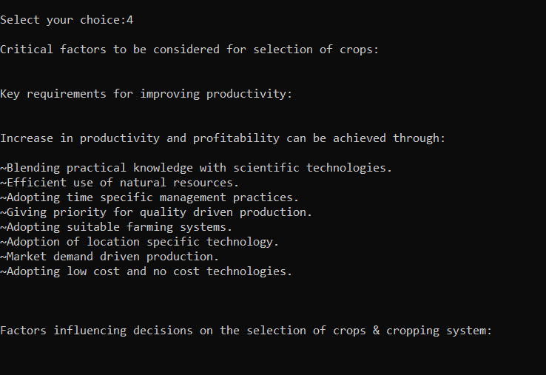
4. Crop Production.

Slide 14
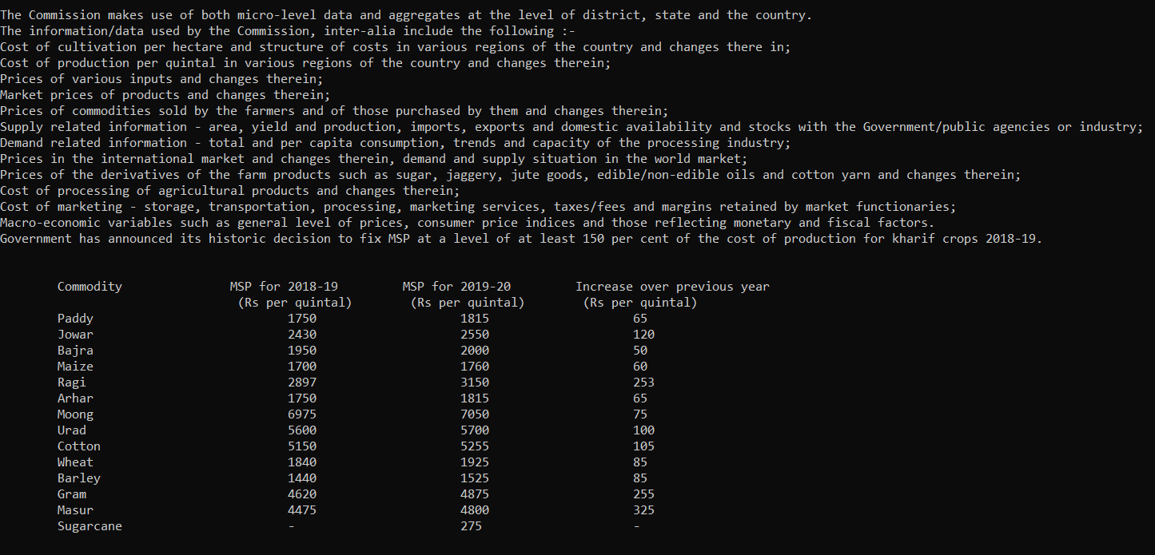
6. Market Information.

Slide 15
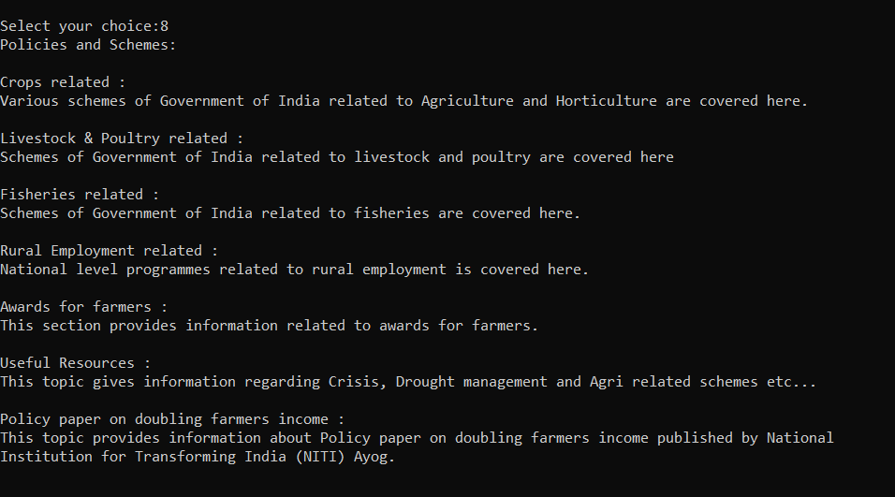
8.Policies And Schemes.

Slide 16
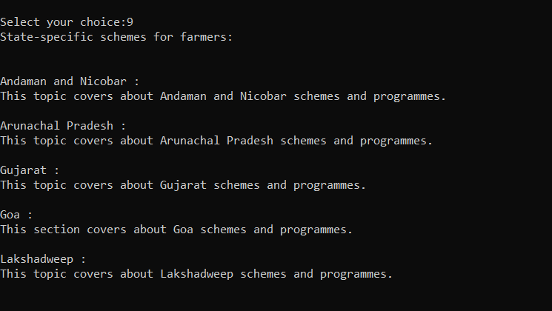
9.State Specific Schemes For Farmers.

Slide 17
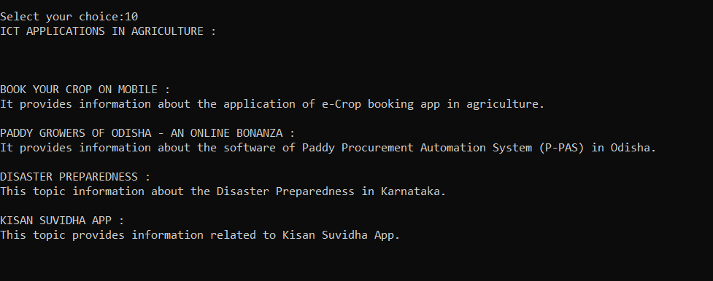
10.ICT Applications In Agriculture.

Slide 18
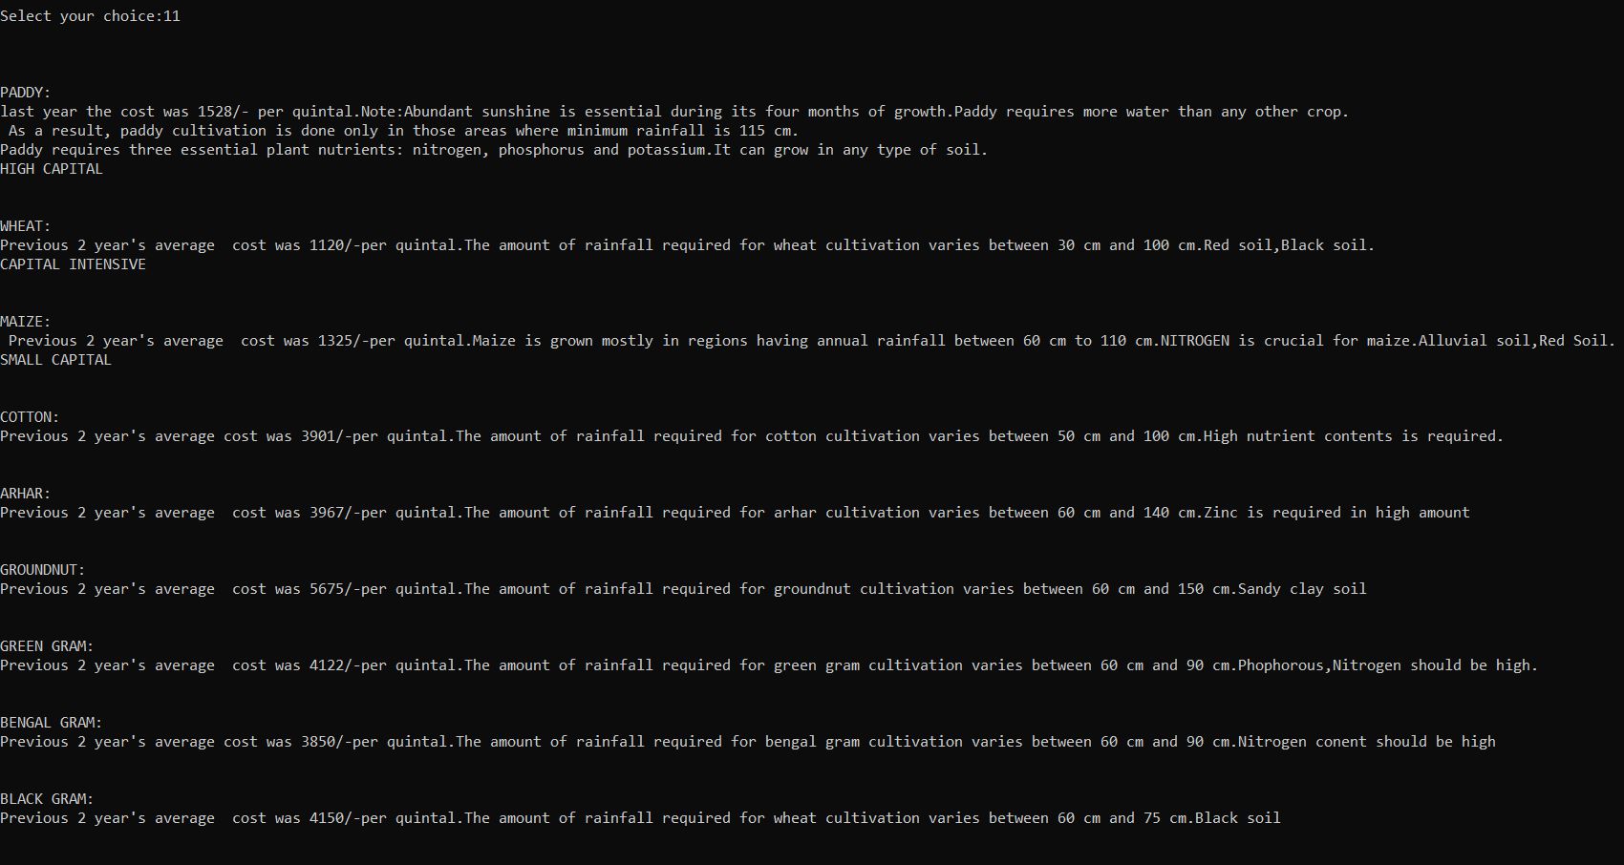
11.Previous Years Analysis Of Crops :

Slide 19
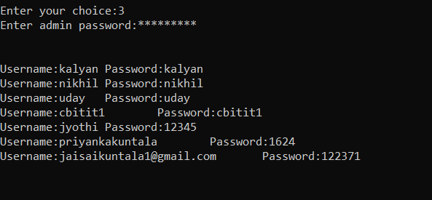
Main Page. (3. Admin Login.)

Slide 20
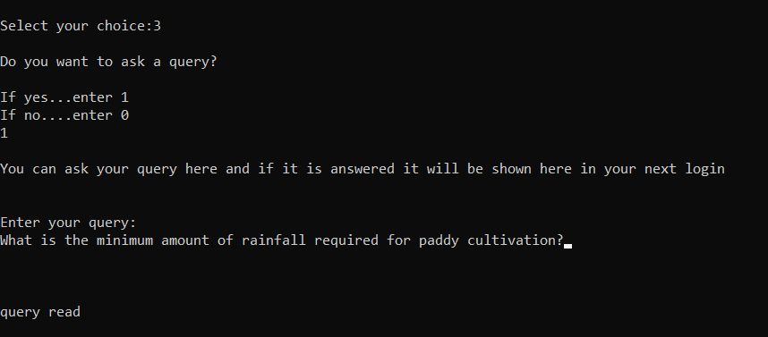
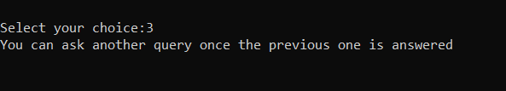
3. Ask A Query.

Slide 21
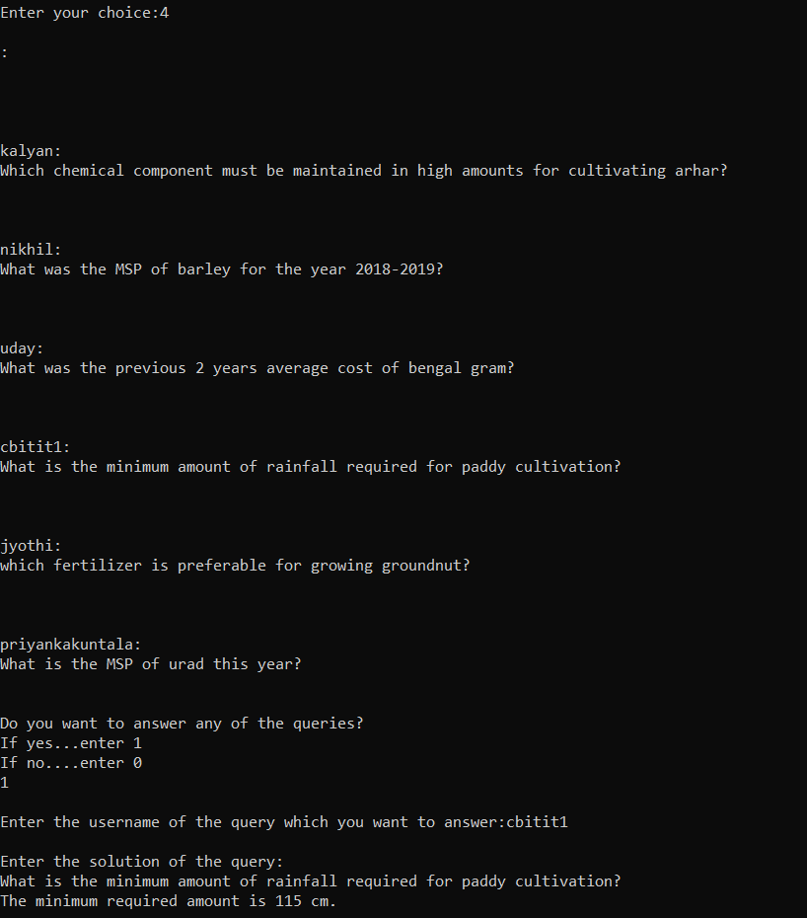
Main Page. (4. Query Clearance.)

Slide 22
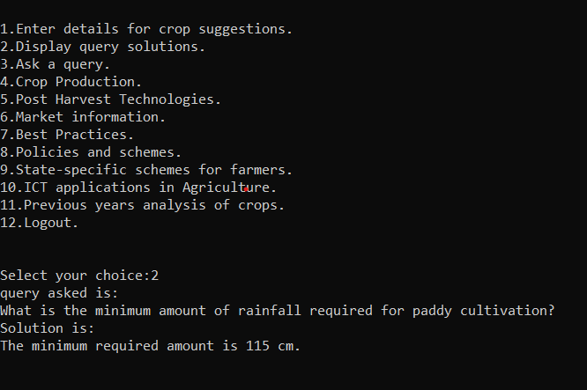
2. Display Query Solutions

Slide 23
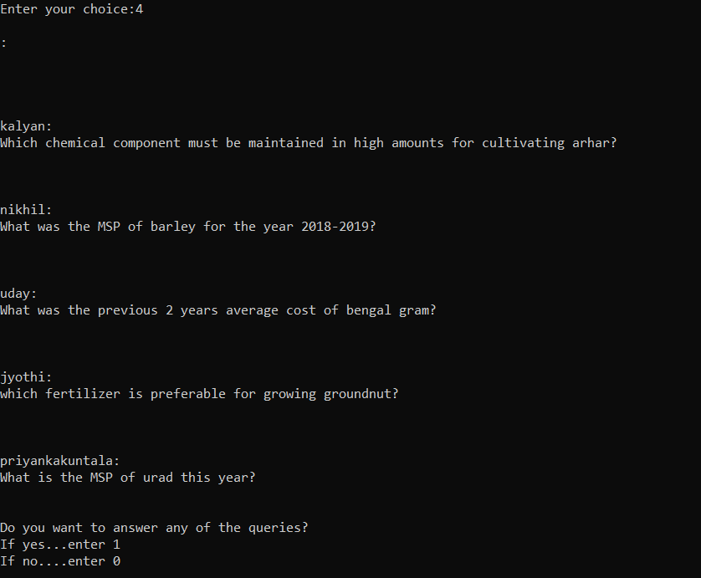
Main Page. (4. Query Clearance.)

Slide 24
Conclusion And Future Scope
As discussed earlier, we were able to accomplish our main objective of bridging the gap between the farmers and the agricultural information by providing vast data in the respective fields and providing the query clearance mechanism.
This project can mainly be enhanced in two ways :
The weather information can directly be linked through the satellites to our project and therefore the crops can be suggested more precisely based on the information as the weather is dynamic.
The information regarding the solutions of their queries, policies and schemes in their states, etc. can be sent as a text message to their mobile phones.

